Slide 1
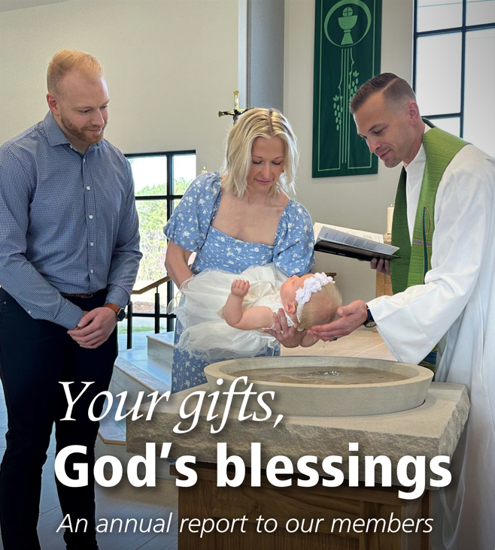
2026
Notes:
Someone at your church may present this PowerPoint using these slides and notes (it’s also helpful to have the full annual report for reference—go to wels.net/annualreport). If you prefer, you can invite one of your congregation’s WELS Christian giving counselors to give the presentation. Find your local Christian giving counselors at wels.net/givingcounselors or call WELS Ministry of Christian Giving at 414-256-3209 / 800-827-5482.
Pictured: A baptism at Huntersville Lutheran, Huntersville, N.C.

Slide 2
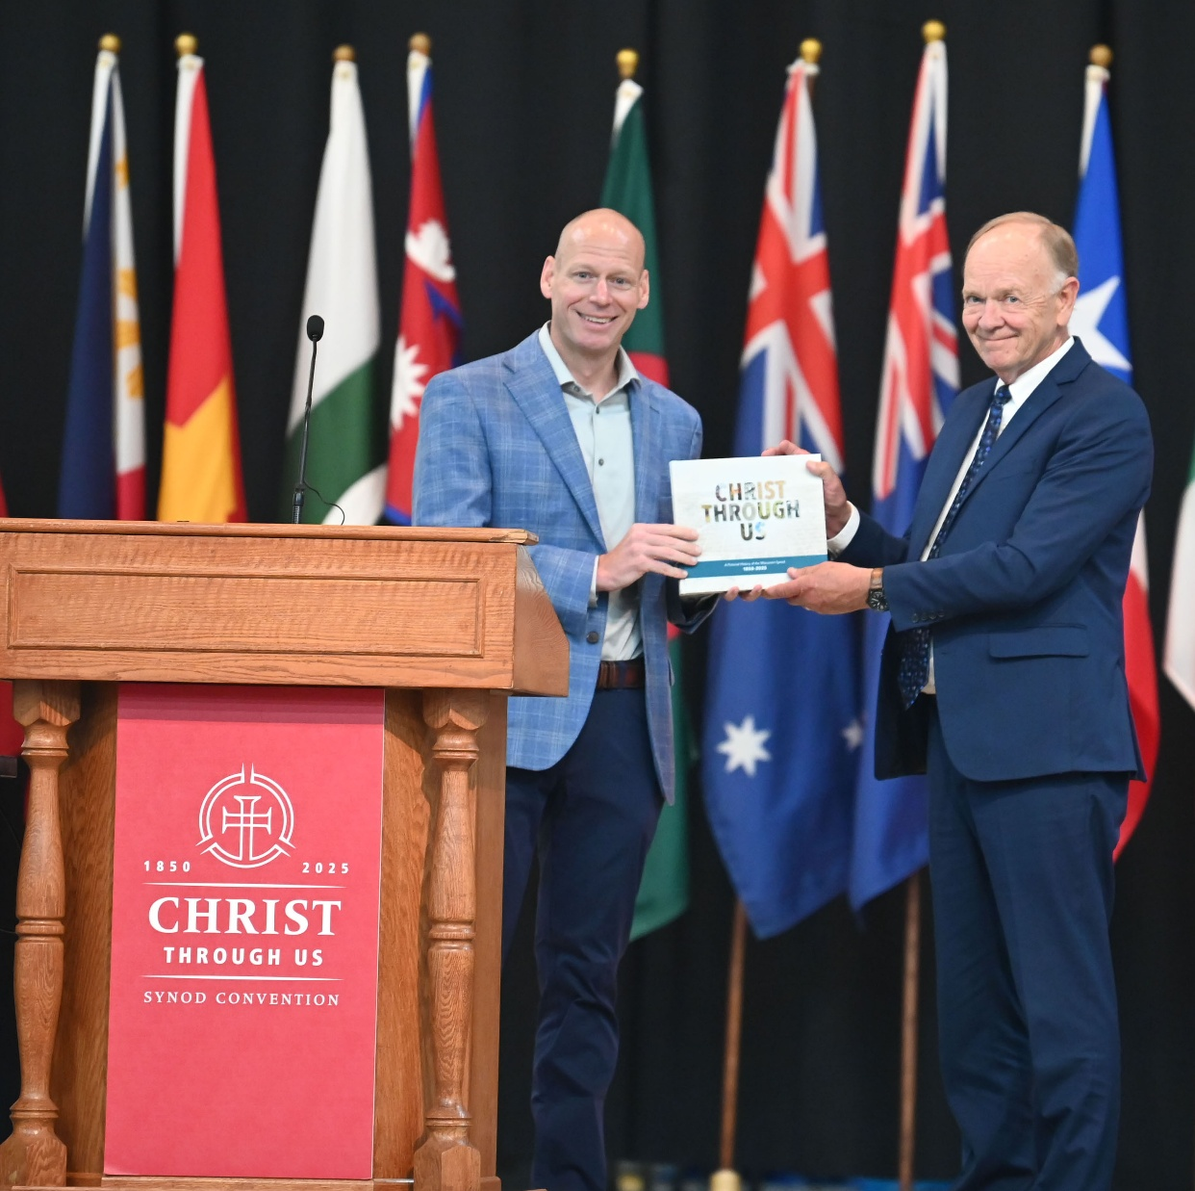
Message from the President
God’s faithfulness to our synod is steadfast:
Well-trained workers
Congregational worship and outreach
100 Missions in 10 Years
Numerous World Missions opportunities
“Christ through us” long-range strategic plan
We marvel at God’s faithfulness.
Notes:
Pictured: WELS’ 68th biennial convention was held July 21–24, 2025, at Martin Luther College, New Ulm, Minn. The theme, “Christ through us,” underscored God’s blessings to WELS as it celebrated its 175th anniversary. Jeremy Angle, Northwestern Publishing House’s president, presented President Mark Schroeder with the pictorial book prepared for the anniversary.

Slide 3
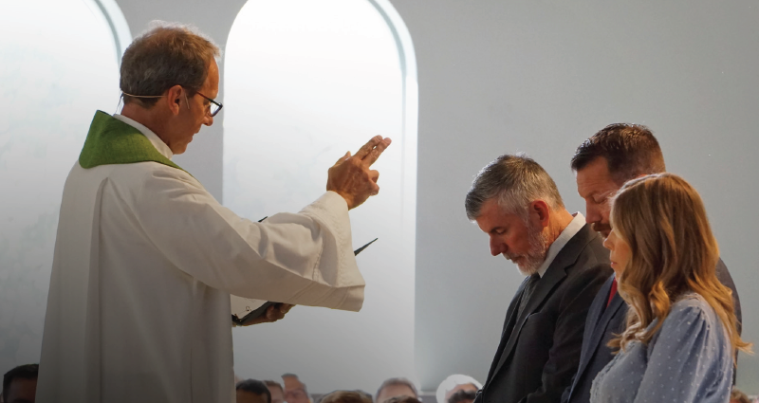
CALLED TO PREPARE
MINISTERIAL EDUCATION
Prepares pastors, teachers, and staff ministers to proclaim Christ’s love in congregations, schools, and mission fields.
Includes three levels at four schools.
Called new administrator and three ministry recruitment counselors.
Notes:
Pictured: Duane Rodewald, chairman of the Board for Ministerial Education, installing ministry recruitment counselors Mary Heckendorf, Mark Schroeder, and Sam McKenna during a service at Wisconsin Lutheran Seminary on Oct. 20, 2025.
New administrator: Rev. Charlie Vannieuwenhoven began serving as administrator of WELS Board for Ministerial Education in January 2026.

Slide 4
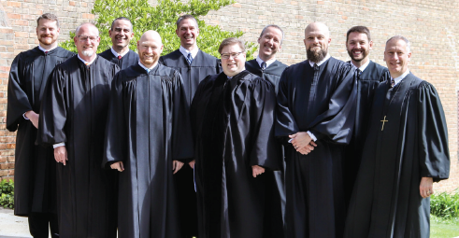
CALLED TO PREPARE
Wisconsin Lutheran Seminary, Mequon, Wis.
Is preparing 153 men for pastoral ministry.
The Pastoral Studies Institute provides training to men of other cultures and educational consultation for seminaries in our fellowship throughout the world.
Grow in Grace, which provides continuing education, celebrated the 15th anniversary of its Pastor Partners Mentoring Program.
Notes:
Enrollment is as of 2025-2026 school year.
Juniors: 30
Middlers: 45
Vicars: 37
Seniors: 41
Pastor Partners Mentoring Program: Almost 250 men have completed the three-year program that partners a new seminary graduate with an experienced pastor for growth and encouragement.
Pictured: Nine pastors completed the Master of Sacred Theology (STM) degree in 2025 through Grow in Grace.

Slide 5
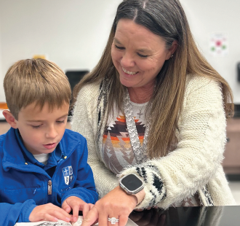
CALLED TO PREPARE
Martin Luther College, New Ulm, Minn.
Serves 650 undergraduates and 140 graduate students.
Prepares men for pastoral training at the seminary and men and women for teaching and staff ministry.
New APPLE program gives returning adult learners a pathway to an elementary teaching ministry degree without requiring them to leave their jobs in WELS schools.
The Principal Training Program coordinates field training for interested graduates.
Notes:
Enrollment is as of 2025-2026 school year.
APPLE: Alternative Pathway to Professional Licensure Eligibility
Pictured: After years of working as an assistant teacher and substitute teacher at Divine Savior Academy–Santa Rita Ranch, Liberty Hill, Texas, Terri Kulick realized she could turn her love for God and her students into a teaching career— with help from Martin Luther College’s APPLE program.

Slide 6

CALLED TO PREPARE
Luther Preparatory School, Watertown, Wis., and Michigan Lutheran Seminary, Saginaw, Mich.
Prepare high school students for future service as pastors, teachers, staff ministers, and congregational leaders.
LPS serves 393 students.
MLS serves 194 students.
Notes:
Enrollments as of the 2025-2026 school year.
Pictured: Michigan Lutheran Seminary’s 2025 graduation service.

Slide 7
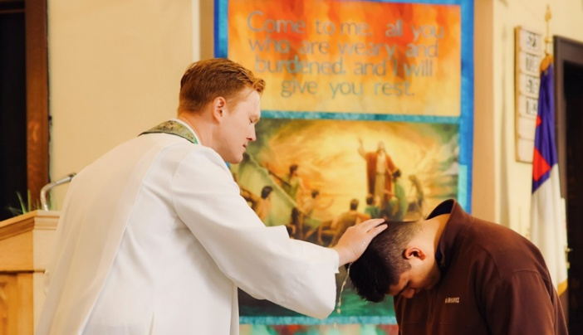
CALLED TO PROCLAIM
HOME MISSIONS
Plants and assists mission-minded churches in the U.S., Canada, and English-speaking West Indies.
Supports 151 home mission congregations.
Supports nearly 50 campus ministries.
Notes:
Pictured: Pastor Samuel Schulz baptizes Jay, who first came to a Bible study on the University of Wisconsin–Whitewater campus. Jay hadn’t grown up Christian. His parents were immigrants from India and practiced a nominal, cultural Hinduism. In God’s Word, he found answers to the biggest questions of life— answers that were not to be found in the worldview of his upbringing. These answers, however, came with a cost. According to Jay, baptism was off the table—his family would view this as an unforgivable betrayal of their culture and possibly disown him. A few months into the school year, Jay stayed after Bible study to ask questions like normal, but this question was different. This question was far more difficult: “Is it really worth it, Pastor?” How ironic that Jay’s most devastating question was the only one that could be answered with a single word: “Yes.”

Slide 8
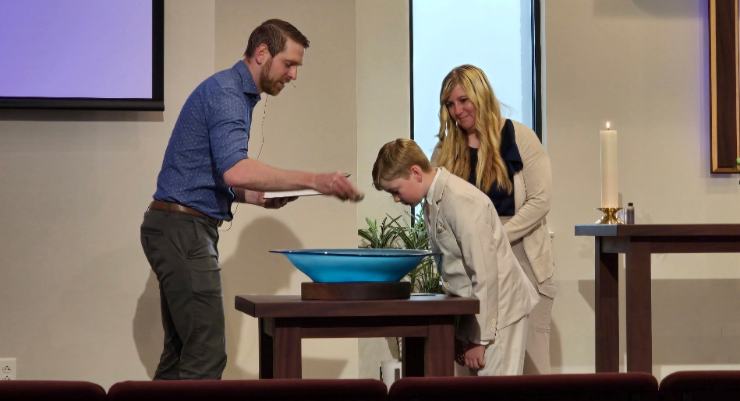
CALLED TO PROCLAIM
100 Missions in 10 Years
Approved 12 new home missions and 6 enhancements in 2025.
Learn more at wels100in10.net.
Notes:
Pictured: Members of Ascension, Jacksonville, N.C., formed a core group to begin a new church about an hour away in Wilmington. In 2025, WELS Board for Home Missions granted support for this mission. Here, Pastor Steven Saatkamp conducts a baptism.

Slide 9
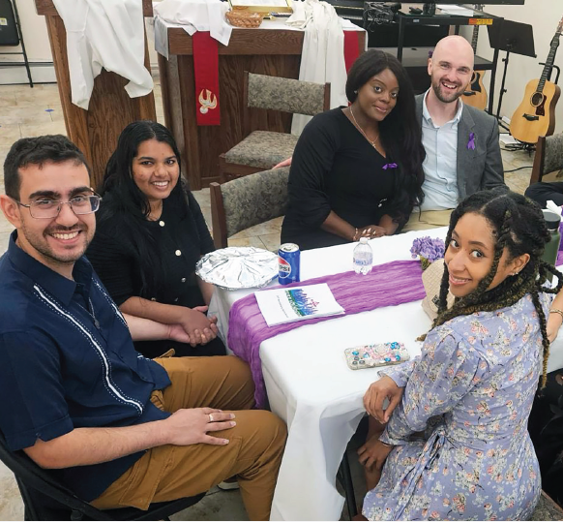
CALLED TO PROCLAIM
HOME MISSIONS
Sure Foundation, Woodside, N.Y., celebrated its 25th anniversary. The mission is thriving in New York City, and the members “from every nation, tribe, people, and language,” are a “small glimpse of heaven.”

Slide 10
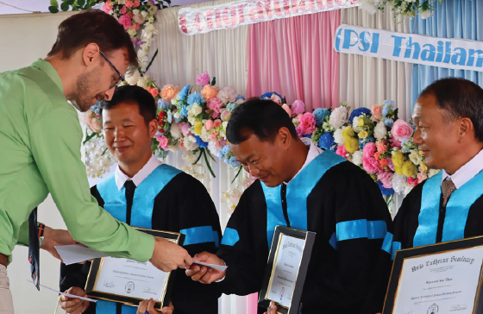
CALLED TO PROCLAIM
WORLD MISSIONS
Conducts gospel outreach in 49 countries and is exploring opportunities in 16 additional countries.
Fifty missionaries partner with more than 500 national pastors to conduct outreach and train more than 400 students for service in Christ’s kingdom.
Notes:
Pictured: In 2025 the churches in Thailand celebrated the graduation of three evangelists from the pastoral studies program run with the assistance of Asia Lutheran Seminary’s Regional Theological Education Program. Two of these three men will continue their work planting churches in two different nearby villages. The third will help support the ministry of another church in the area.

Slide 11
CALLED TO PROCLAIM
WORLD MISSIONS
Africa: Missionaries partner with national church bodies in 7 countries and are exploring outreach with 12 groups in 10 additional countries throughout the continent.
Asia-Oceania: Seventeen missionaries have joined together to equip, encourage, and empower others to bring the gospel to 1.8 billion unreached souls.
Europe: Missionaries partner with national churches to train the next generation of church leaders and bring the gospel to countries without a strong Lutheran presence.

Slide 12
CALLED TO PROCLAIM
WORLD MISSIONS
Latin America: Tens of thousands of people are being reached through Academia Cristo online courses, and 45 individuals are actively leading a group in worship and study.
Multi-Language Productions: Produces materials in more than 56 languages and reaches tens of thousands of English-speakers in more than 30 countries through the TELL online training platform.
Native American reservations: The gospel is being shared on the Apache reservations, and the Native Christians Network has begun outreach to additional tribes.

Slide 13
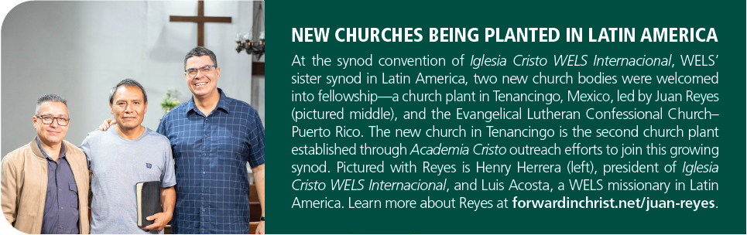
CALLED TO PROCLAIM
WORLD MISSIONS

Slide 14
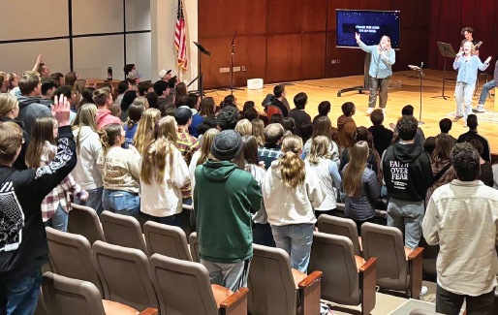
CALLED TO SERVE
CONGREGATIONAL SERVICES
Encourages and equips congregations for faithful and fruitful gospel ministry.
Includes Congregational Counseling, Discipleship, Evangelism, Special Ministries, Worship, and Lutheran Schools.
Organizes national conferences where called workers and laypeople can discuss best ministry practices.
Produces a wide variety of resources, available at welscongregationalservices.net.
Notes:
Pictured: A WELS Youth Night hosted by Wisconsin Lutheran College for youth in the Milwaukee area. WELS Discipleship offers a series of youth-focused events with the aim of gathering youth from congregations in geographic proximity for fellowship and Scripture study. This resource provides all the pieces needed to plan, train, promote, and host a Youth Night event. Every package in the series has its own unique event theme, keynote video, and small group discussion guide.

Slide 15
CALLED TO SERVE
CONGREGATIONAL SERVICES highlights
Amazing Grace Virtual Academy, a fully accredited online WELS high school, celebrated its first graduation of fully online learners on May 15, 2025.
WELS Mission for the Deaf and Hard of Hearing
created an online religious sign language dictionary to help the deaf and interpreters share the gospel more effectively. Visit gospelhands.net.
held a conference focused on better ministering to deaf and hard of hearing members. Forty people participated, including 20 deaf/hard of hearing individuals.

Slide 16
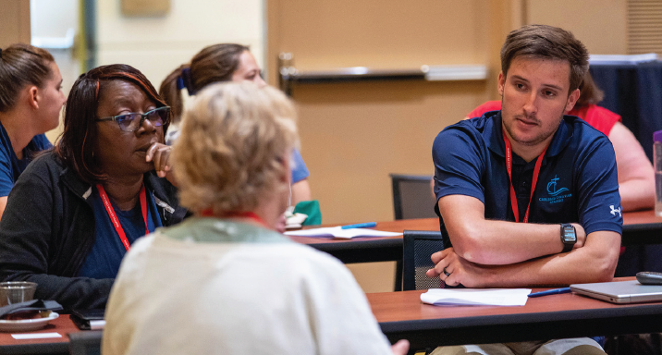
CALLED TO SERVE
CONGREGATIONAL SERVICES highlights
Sixty percent of congregations are using The Foundation, a suite of resources built around the weekly worship theme.
Statistical analysis: 2024 marks the fourth straight year that total adult confirmations increased.
Notes:
Pictured: The WELS Education Conference was held June 23–25, 2025, in Green Bay, Wis. About 450 educators participated.

Slide 17
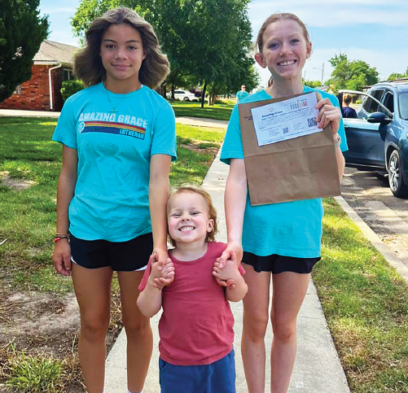
CALLED TO SERVE
CHRISTIAN AID AND RELIEF
Approved $426,357 to support humanitarian aid projects in WELS mission fields in 2025-26.
Provides disaster relief to those experiencing hardships.
Churches can use grants for compassion ministry in their communities.
Notes:
Pictured: Amazing Grace, Amarillo, Texas, is using Christian Aid and Relief grant funds in multiple ways—providing school supplies to kids in need, delivering meals door to door in community neighborhoods, and helping feed those who are homeless. Hans Thomford, pastor at Amazing Grace, says, “These grants help us to love our community and put ourselves and our new mission around even more people in need of Jesus’ love and forgiveness! The compassion net can really go a great distance with these funds.”

Slide 18
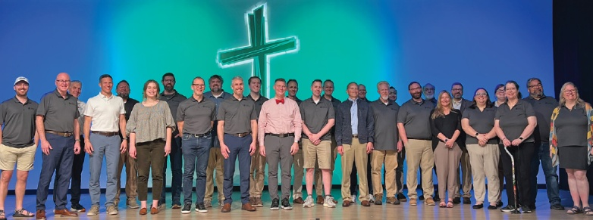
CALLED TO SERVE
WELS TECHNOLOGY: Organized an event to discuss the intersection of Artificial Intelligence and the church and is working to provide resources that can help ministries across the synod as this technology continues to develop.
MINISTRY OF CHRISTIAN GIVING: Coordinated offerings for WELS’ 175th anniversary, a new music center at Luther Preparatory School, and building enhancements at Wisconsin Lutheran Seminary.
Notes:
WELS Ministry of Christian Giving has 13 Christian giving counselors located across the 12 districts of WELS to provide free, confidential gift planning assistance to WELS members. Find your local giving counselor at wels.net/givingcounselors, by calling 800-827-5482, or by e-mailing mcg@wels.net.
Pictured: Artificial Intelligence discussion group

Slide 19
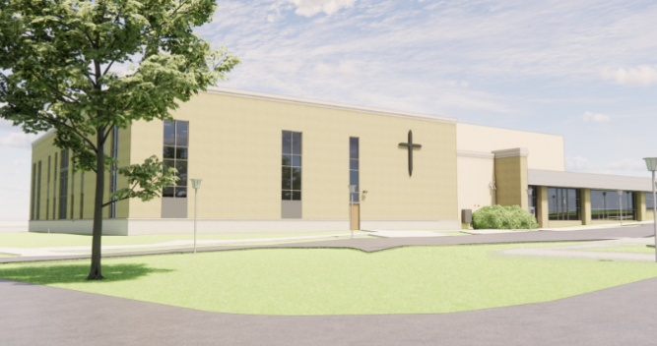
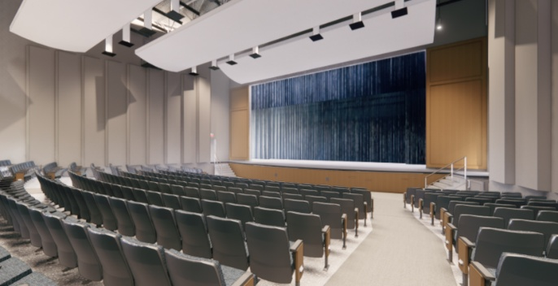
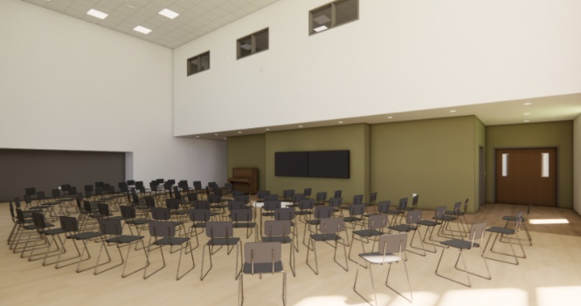
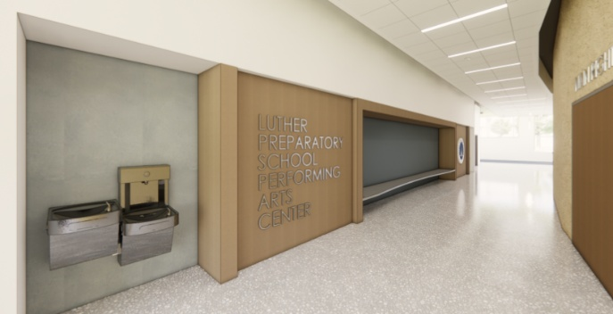
CALLED TO SERVE
MINISTRY OF CHRISTIAN GIVING capital campaigns “Magnify” campaign for a new music center at Luther Preparatory School
Notes:
Luther Preparatory School is seeking to build a new music center. The current auditorium building has had many renovations and modifications to maximize its use, but it is no longer ideal for classes, practices, and performances.
The proposed center will have sloped seating, designated band and choir spaces, right-sized classrooms, piano studios, and practice rooms. Gifts and commitments are currently at $8.26 million toward the $16 million goal. Construction can begin at 70 percent or $11.2 million.

Slide 20
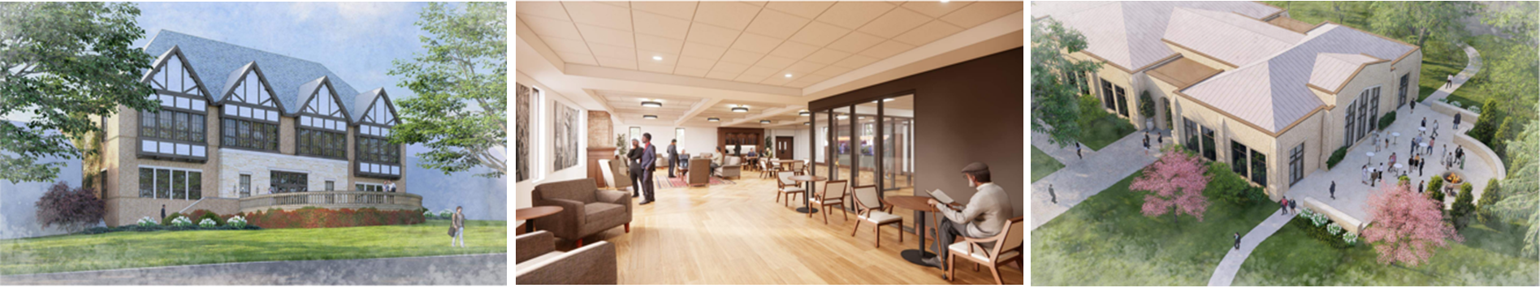
CALLED TO SERVE
MINISTRY OF CHRISTIAN GIVING capital campaigns
“Compelled” campaign for a new education center, faculty offices, and gathering hall at Wisconsin Lutheran Seminary
Notes:
Pictured left to right: Proposed education center, library, and gathering hall.
We are seeking gifts and commitments totaling about $11 million (70 percent of the $15.5 million project) for the school’s education wing, remodeled faculty offices, and auditorium gathering space. By God’s grace, we’ve received $7.55+ million in gifts and commitments. In addition, WLS has $3 million in discretionary funds that may be used.

Slide 21
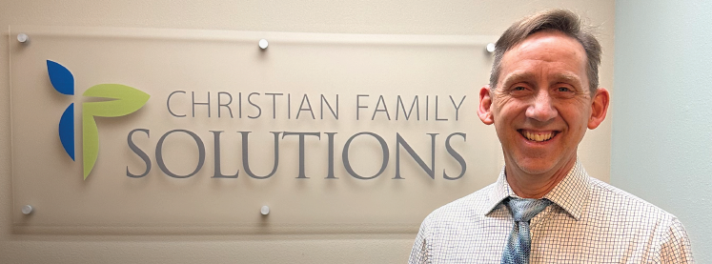
CALLED TO SUPPORT
WELS INVESTMENT FUNDS
Celebrated its 25th anniversary.
Provides cost-effective, professionally managed investment portfolios for purposes like endowments, scholarships, and building funds.
Oversees more than $350 million in assets for more than 260 WELS organizations.
Notes:
Pictured: St. Paul, Muskego, Wis., was the first congregation to invest with WELS Investment Funds. Proceeds invested through WELS Investment Funds helped St. Paul, Muskego, Wis., open a community counseling center as well as support one of its pastors, Jeffrey Bonack, to pursue his master’s degree in counseling.

Slide 22
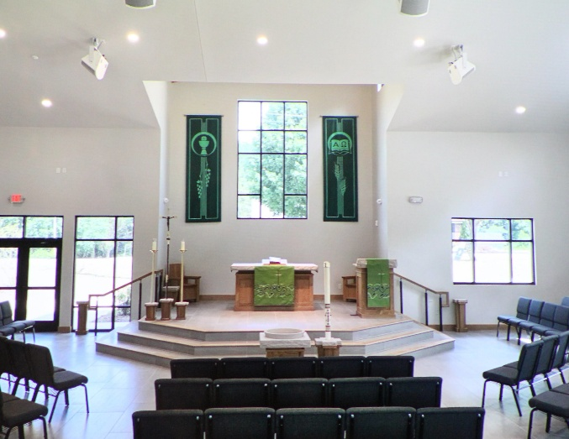
CALLED TO SUPPORT
WELS CHURCH EXTENSION FUND provides loans and grants for WELS home missions and mission-minded congregations through member gifts and investments.
In 2024–25, $19.8 million of new loans and $4.5 million of new grants were approved.
CEF disbursed $1.3 million in grants to Home Missions.
Notes:
Pictured: On July 26, 2025, Huntersville Lutheran, Huntersville, N.C., dedicated its new worship facility. WELS CEF helped the church with a loan and a grant for the project.

Slide 23

CALLED TO SUPPORT
NORTHWESTERN PUBLISHING HOUSE
Publishes Forward in Christ, Meditations: Daily Devotional, elementary and Sunday school curricula, Bible studies, worship materials, music, and faith-strengthening books.
Released more than 25 Christian resources in print and digital formats, including the People’s Bible Devotions series.

Slide 24
CALLED TO SUPPORT
WELS FOUNDATION
Helps individuals and organizations make planned gifts to the ministries they care about, including WELS congregations, schools, missions, and special ministries.
Distributed $8.5 million to ministry in 2024-25.
Coordinates charitable gift annuities, charitable remainder trusts, donor-advised funds, endowments, and gifts of appreciated assets.

Slide 25
CALLED TO SUPPORT
WELS BENEFIT PLANS
Serves WELS and ELS workers and organizations through the administration of the WELS Voluntary Employees’ Beneficiary Association (VEBA) Health Plan, the WELS Pension Plan, and the WELS Shepherd Plan.
Provides uniform coverage and benefits throughout all 50 states.
Serves more than 80 percent of WELS workers and calling bodies through WELS VEBA.

Slide 26
CALLED TO SUPPORT
FINANCIAL SERVICES
WELS’ financial position is strong with consistent levels of giving and healthy reserves.
Congregation Mission Offerings, which fund 70 percent of WELS’ operating budget, were $24.0 million in fiscal year 2025.
The Financial Stabilization Fund supports about 30 percent of WELS’ operating budget with undesignated, non-CMO funding.

Slide 27
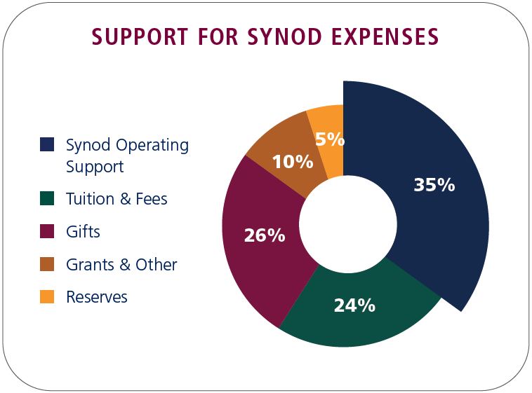
CALLED TO SUPPORT
FINANCIAL SERVICES
Total synod expenses of about $100 million are covered by Synod Operating Support—consisting of CMO and the Financial Stabilization Fund (approximately 35 percent)—as well as tuition and fees, reserves, gifts, and grants (approximately 65 percent).

Slide 28
WELS in brief
WELS’ calling: Nurture the faith of members and spread the gospel of Jesus Christ throughout the world.
Third largest Lutheran church body in the United States
1,237 churches
327,943 baptized members
261,357 communicant members
One of the largest parochial school systems in the U.S.
269 elementary schools
335 early childhood ministries
29 area Lutheran high schools

Slide 29
WELS in brief
Twelve districts allow for more area-specific ministry.
WELS is a member of the Confessional Evangelical Lutheran Conference, an organization of 34 confessional church bodies throughout the world.
WELS’ headquarters is in Waukesha, Wis.

Slide 30
WELS in brief
From collections that document the administration of WELS to individual congregational records, the WELS Archives helps preserve and share the history of our synod.

Slide 31
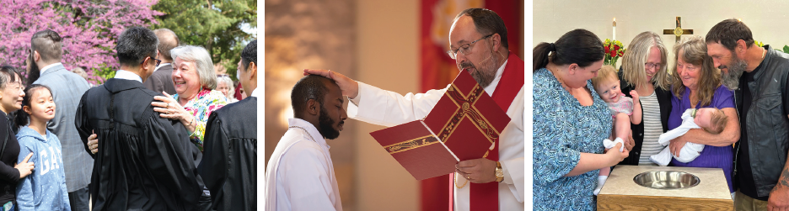

Thank you for your support!
N16W23377 Stone Ridge Drive Waukesha, WI 53188-1108 wels.net

